Slide 1

AI-BASED WASTE SEGREGATION AND DISPOSAL GUIDE
Using Artificial Intelligence for Smart and Sustainable Waste Management
Presented by:
Kusuma Vadde
B.Tech-Artificial Intelligence and Machine Learning
Mohan Babu University
SDG 12 – Responsible Consumption and Production

Slide 2


IMPROPER WASTE SEGREGATION PROBLEM
  Different types of waste are often mixed together.
  People may not know which bin is appropriate for a particular waste item.
  Improper segregation makes recycling more difficult.
  Hazardous and electronic waste require special handling.
  This can lead to environmental pollution and inefficient waste management.
  “How can AI help people identify and dispose of waste correctly?”

Slide 3


SDG 12: RESPONSIBLE CONSUMPTION AND PRODUCTION
  SDG 12 promotes responsible consumption and production by reducing waste, using resources efficiently, and encouraging sustainable practices.
Correct Waste Segregation
Better Waste Management
Sustainable Practices
AI Waste Guide

Slide 4
AI ROLE & PROPOSED SOLUTION
  An AI-based waste guide that helps users identify a waste item and provides suitable segregation and disposal guidance
Where AI is Used:
  Image/Text Understanding
  Waste Classification
  Decision Support
AI Classifies the Waste
User Input
Image or text of waste item
Disposal Guidance
AI Identifies the Item
Organic
Recyclable-Dry waste

Slide 5
TARGET USERS & DESIGN THINKING
Target Users:
  Students – to identify waste and choose the correct bin.
  Households – to get quick guidance for everyday waste.
  Office Users – to support proper waste segregation.
  Community Members – to improve awareness of responsible disposal.
Improve Through Feedback
Understand User Needs
Design the Solution
Build the Prototype

Slide 6
HOW THE AI WASTE GUIDE WORKS
Image Input
AI Analysis
Waste Classification
Disposal Guidance
User uploads a waste-item image.
AI identifies the item in the image
  Organic / Wet
  Recyclable / Dry
  Hazardous / E-Waste
Provides simple instructions for proper disposal.

Slide 7
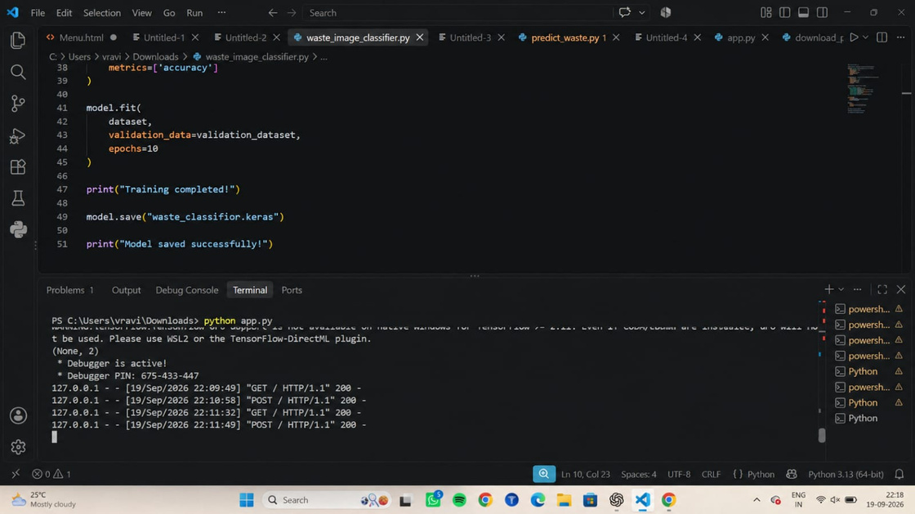
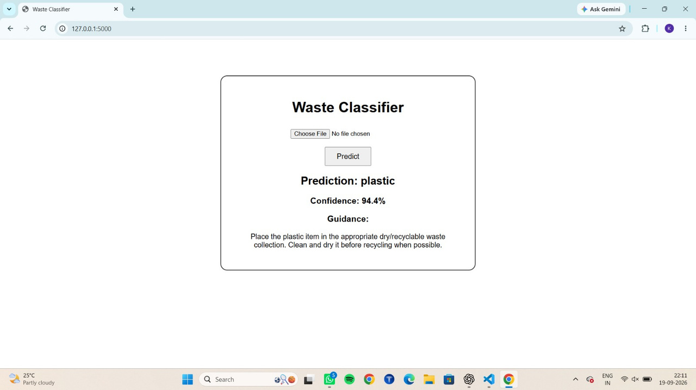
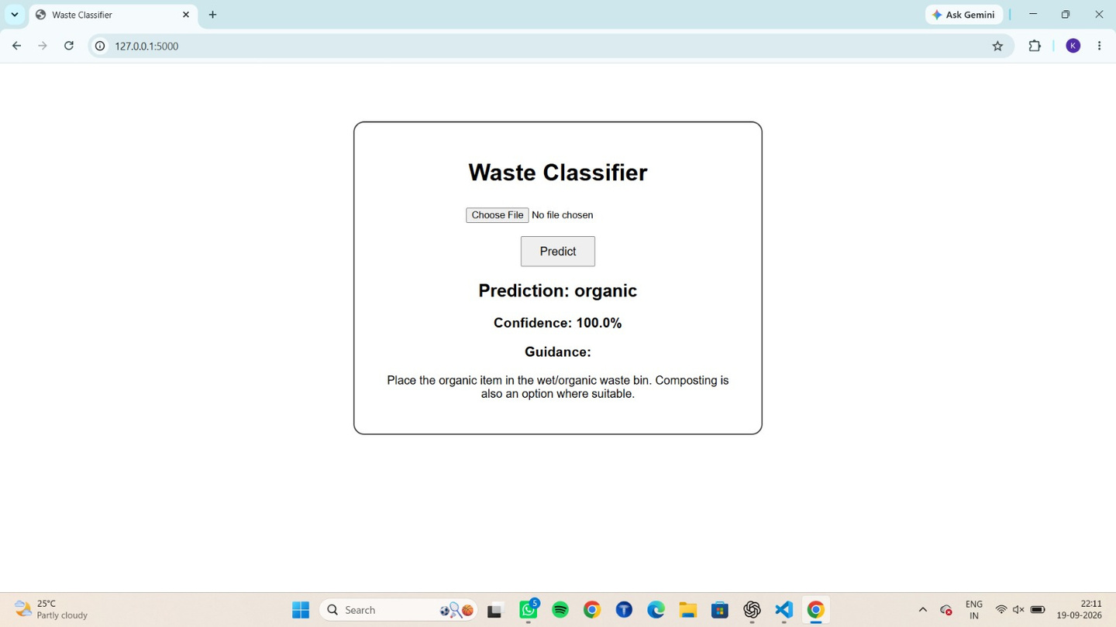
PROTOTYPE
Code:
Prototype Details:
  Tool : Python + VS Code
  Input : Image
  AI : Image Classification.
  Output : Disposal recommendation
Output:

Slide 8
RESPONSIBLE AI CONSIDERATIONS
Accuracy
Safety
Privacy
Human Oversight
Accessiblity
Provide reliable waste classification
Follow proper guidance for hazardous
Avoid collecting unnecessary personal data
Users should verify uncertain results
Keep guidance simple and easy to understand
Key Principle:
Use AI responsibly, safely, and with human awareness

Slide 9
EXPECTED IMPACT
Easier Segregation
Quick Identification
Better Disposal
Sustainable Habits
Helps users sort waste correctly
Helps identify unfamiliar waste items
Provides simple disposal
Encourages responsible waste management
Impacts Statement:
Makes responsible waste segregatiom simple and accesible

Slide 10
CONCLUSION & LEARNING
What I Learned
  Identified a real-world waste problem
  Connected it with SDG 12
  Explored AI for waste classification
  Developed a simple image-based prototype
  Learned about responsible AI
Final Message:
AI can support sustainability when designed with purpose, responsibility and real user needs

Slide 11
THANK YOU

